Slide 1
أكـــــاديميــــة طــــويـــق
Deep Learning

Slide 2
Variational Autoencoders (VAEs)
By: Dr. Afshan Hashmi

Slide 3
Topics Covered:
What is an Variational Autoencoder
Working of Variational Autoencoders
Architecture of Variational Autoencoders
Loss Functions in Variational Autoencoder
Types of Autoencoders
GAN vs VAE
Application of Variational Autoencoders
Implementation of VAE (Image Compression+ Anomaly Detection)

Slide 4
Variational Autoencoders (VAEs)
Variational Autoencoders (VAEs) are a type of generative model that combine principles from neural networks and Bayesian inference. Unlike traditional autoencoders that learn a fixed, compressed representation of data, VAEs take a probabilistic approach.
Here's what makes VAEs different:
Probabilistic Latent Space: Instead of learning a single point in the latent space for each input, VAEs learn a distribution (typically a Gaussian distribution) over the latent space. This means for each input, the encoder outputs parameters (like mean and variance) of a distribution, rather than a single vector.
Generative Capability: This probabilistic nature allows VAEs to generate new data samples. By sampling from the learned latent distribution and passing these samples through the decoder, VAEs can create novel outputs that resemble the training data.
Applications: They are particularly effective in tasks such as generating realistic images, text synthesis, and other creative applications where generating new, diverse data is desired.

Slide 5
How Do VAEs Work?
VAEs operate with an encoder-decoder architecture, but with a crucial probabilistic twist in the latent space.
The Encoder and Decoder in VAEs
1. Encoder:
Outputting Distribution Parameters: In a VAE, the encoder doesn't directly output a single latent vector for an input. Instead, for each input data point (x), it outputs the parameters of a probability distribution in the latent space, most commonly a Gaussian (normal) distribution.
Mean (μ): Represents the center or most probable value of this learned distribution.
Variance (σ2) (or log-variance, logσ2): Measures how spread out or uncertain this distribution is.
Purpose: The encoder learns to map the input data to a distribution in the latent space, rather than a fixed point.
2. Latent Space Sampling (The Reparameterization Trick):
The Challenge: During training, we need to be able to backpropagate gradients through the sampling process. Directly sampling from a random distribution is not differentiable.

Slide 6
How Do VAEs Work?
The Solution (Reparameterization Trick): To overcome this, instead of directly sampling z from the
Gaussian distribution N(μ,σ2), we sample a random variable ϵ from a standard normal distribution
(mean 0, variance 1). We then transform this ϵ using the μ and σ parameters output by the encoder to get our latent vector z. This transformation makes the sampling process deterministic with respect to μ and σ, allowing gradients to flow.
Formula: z=μ+σ⊙ϵ Where:
z: The sampled latent vector that will be passed to the decoder.
μ: The mean vector output by the encoder.
σ: The standard deviation vector (derived from the variance output) by the encoder.
ϵ: A random sample drawn from a standard normal distribution N(0,1).
⊙: Denotes element-wise multiplication.
3. Decoder:
Input: The decoder takes the sampled latent vector (z) (obtained via the reparameterization trick) as its input.
Reconstruction: Its objective is to reconstruct the original input data (x) from this latent vector.
Output Distribution Parameters: Like the encoder, the decoder typically outputs parameters for an output distribution (e.g., mean and variance for a Gaussian output for continuous data, or probabilities for a Bernoulli distribution for binary data), from which the reconstructed data is sampled.
In summary, VAEs encode an input into a distribution over the latent space, sample from that distribution (using the reparameterization trick), and then decode that sample back to reconstruct the original input, all while ensuring differentiability for training.

Slide 7
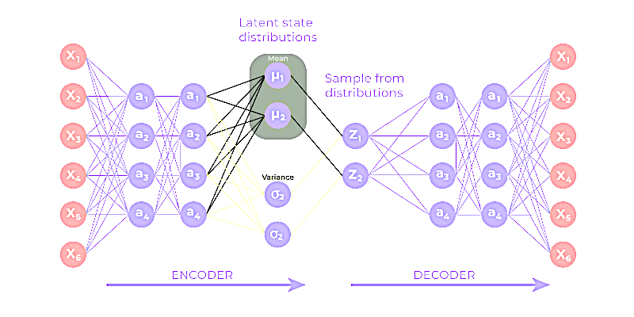
Architecture of Variational Autoencoder
VAE is a special kind of autoencoder that can generate new data instead of just compressing and
reconstructing it. It has three main parts:
1. Encoder (Understanding the Input)
The encoder takes the input data like an image or text and tries to understand its most important features.
Instead of creating a fixed compressed version like a normal autoencoder it creates two things:
Mean (μ): A central value representing the data.
Standard Deviation (σ): It is a measure of how much the values can vary.
These two values define a range of possibilities instead of a single number.

Slide 8
Architecture of Variational Autoencoder
2. Latent Space (Adding Some Randomness)
Instead of encoding input into a fixed number VAEs introduce randomness to create variations.
The model picks a point from the range to create different variations of the data.
This is what makes VAEs great for generating new slightly different but realistic data.
3. Decoder (Reconstructing or Creating New Data)
The decoder takes this sampled value and tries to reconstruct the original input.
Since the encoder creates a range of possibilities instead of a fixed number the decoder can generate new similar data instead of just memorizing the input.

Slide 9
Loss Functions in VAE Training
VAEs use a combined loss function to achieve both accurate reconstruction and a well-structured latent space.
Reconstruction Loss (or Reconstruction Error):
Purpose: Measures the difference between the original input data (x) and the reconstructed output from the decoder.
Common Functions:
Mean Squared Error (MSE): For continuous data.
Cross-Entropy Loss: For binary data (e.g., images with pixel values 0 or 1).
Goal: To optimize the decoder's parameters (θ) such that pθ​(x∣z) accurately reconstructs x given latent variable z.
Limitation (for VAEs): While sufficient for standard autoencoders, reconstruction loss alone can lead to an irregular latent space that overfits and doesn't generalize well for generating new samples.

Slide 10
Loss Functions in VAE Training
Kullback-Leibler (KL) Divergence:
Purpose: A regularization term crucial for VAEs to ensure a well-behaved latent space suitable for generation.
Problem it Solves: Without KL divergence, the latent space might be disjointed (not continuous or complete), making it impossible to sample new, meaningful data "in-between" learned data points.
Mechanism: KL divergence measures the difference between two probability distributions. In VAEs, it forces the learned latent distribution (qϕ​(z∣x)) (output by the encoder) to be similar to a chosen simple prior distribution, typically a standard normal (Gaussian) distribution (N(0,1)).
Benefits (of a Normal Latent Space):
Continuity: Nearby points in latent space decode to similar content.
Completeness: Any point sampled from the latent space yields meaningful content.
Goal: Minimizing KL divergence encourages the encoder to organize the latent space in a continuous and complete manner, facilitating smooth interpolation and generation of new samples.

Slide 11
Loss Functions in VAE Training
Evidence Lower Bound (ELBO)
The Challenge: Directly calculating the true posterior distribution (p(z∣x)) and the marginal likelihood (p(x)) for VAEs is computationally intractable (the denominator is infinite).
The Solution: VAEs don't directly minimize KL divergence (as it involves an intractable term). Instead, they are trained to maximize the Evidence Lower Bound (ELBO).
Definition: ELBO is a lower bound (a worst-case estimate) on the logarithm of the marginal likelihood of the data, logp(x). Maximizing this lower bound effectively pushes up the true log-likelihood, making the model better at explaining the observed data.
Components of ELBO: The ELBO objective combines both the reconstruction loss term and the KL divergence regularization term.

Slide 12
Loss Functions in VAE Training
The Reparameterization Trick
The Problem: The core idea of VAEs is to sample a latent variable z from a distribution output by the encoder. However, directly sampling from a random distribution is a non-differentiable operation, which means backpropagation (used for training neural networks) cannot work through it to update the encoder's parameters.
The Solution: The reparameterization trick allows the random sampling step to be "moved outside" the part of the network that receives gradients.
Mechanism: Instead of sampling z directly from N(μ,σ2):
The encoder outputs the mean (μ) and standard deviation (σ) of the latent distribution.
A random noise value (ϵ) is sampled from a standard normal distribution N(0,1).
The latent variable z is then calculated deterministically as: z=μ+σ⊙ϵ
(⊙ denotes element-wise multiplication)
Benefit: Since ϵ is a fixed random sample that does not depend on the model's parameters, the gradients can flow back through μ and σ (which are dependent on the encoder's parameters), allowing the encoder to be trained effectively using gradient descent (e.g., Adam optimizer) to maximize the ELBO.

Slide 13
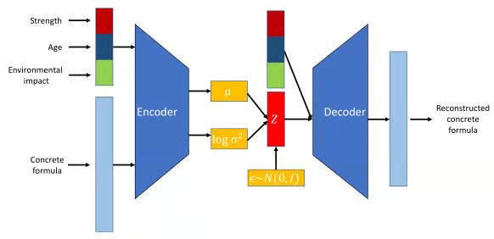
Types of Variational Autoencoders
VAEs have evolved into various specialized forms to address different challenges and applications in machine learning. In this section, we’ll examine the most prominent types, highlighting use cases, advantages, and limitations.
CVAE Model Structure

Slide 14
Types of Variational Autoencoders
Conditional Variational Autoencoder (CVAE)
Description: CVAEs are an advanced form of VAEs that improve the generative process by incorporating additional conditioning information (c). This c is fed into both the encoder and decoder networks and can be any relevant data like class labels, attributes, or other contextual data.
Use Cases:
Controlled Data Generation: Enables creation of data with specific properties (e.g., generating images of particular objects based on labels).
Image-to-Image Translation: Transforms images between domains while preserving specific attributes (e.g., B&W to color, sketches to photos).
Text Generation: Generates text conditioned on specific prompts or topics (e.g., story generation, chatbot responses).
Pros:
Finer control over generated data.
Improved representation learning.
Cons:
Increased risk of overfitting (due to the added complexity of learning conditions).

Slide 15
Applications of VAEs
Generative Modeling:
VAEs excel at generating novel data samples that share characteristics with the training data but are not direct copies.
Useful for creating new artwork, realistic faces, or designs in fields like fashion and architecture.
Anomaly Detection:
By learning the statistical distribution of "normal" data, VAEs can effectively identify data points that deviate significantly from this norm as anomalies.
Applied in areas such as fraud detection, network security, and predictive maintenance.
Data Imputation and Denoising:
Strong at reconstructing data with missing or corrupted parts.
They can predict and fill in missing values or remove noise from corrupted data by sampling from the learned latent distribution.
Valuable in medical imaging for accurate reconstruction and restoring corrupted audio/visual data.

Slide 16
Applications of VAEs
Semi-Supervised Learning:
VAEs can enhance classifier performance in semi-supervised settings.
They use their structured latent space to capture underlying data structures, improving the learning process even with limited labeled data.
Latent Space Manipulation:
VAEs create a structured and continuous latent space that can be directly manipulated.
This allows for controlled modification of data features (e.g., adjusting lighting or facial expressions in images) by navigating this latent space.
Highly useful in creative industries for image and video editing and enhancement

Slide 17
VAEs versus GANs
Both Variational Autoencoders (VAEs) and Generative Adversarial Networks (GANs) are powerful generative models used to create new data samples that resemble a training dataset, particularly in image generation.
Similarities with GANs:
Like VAEs, GANs also have a two-network architecture: a generator (creates samples) and a discriminator (classifies samples as real or fake).
GANs are trained adversarially in a zero-sum game: the discriminator's feedback is used to iteratively improve the generator until it can produce samples indistinguishable from real data.
Comparison for Image Synthesis:
GANs:
Pros: Tend to produce clearer and sharper images.
Cons: Training can be unstable due to the adversarial nature and the inherent tradeoffs between the two competing models.
VAEs:
Pros: Generally easier to train and more stable.
Cons: Tend to produce blurrier images. This often stems from the probabilistic nature of averaging features in the latent space during reconstruction.

Slide 18
VAEs versus GANs
VAE-GANs
Concept: As the name implies, a VAE-GAN is a hybrid model that combines elements of both a Variational Autoencoder and a Generative Adversarial Network.
Purpose: Its primary goal is to reduce the blurriness commonly seen in images generated by standard VAEs.
Mechanism: It achieves this by replacing the VAE's traditional reconstruction loss term (e.g., MSE or BCE) with a discriminator network. This forces the VAE's decoder to produce images that are not just numerically similar to the input, but also realistic enough to fool a discriminator, thereby enhancing clarity and perceptual quality.

Slide 19
Implementation of VAE
1. Anomaly detection
2. Image Compression

Slide 20
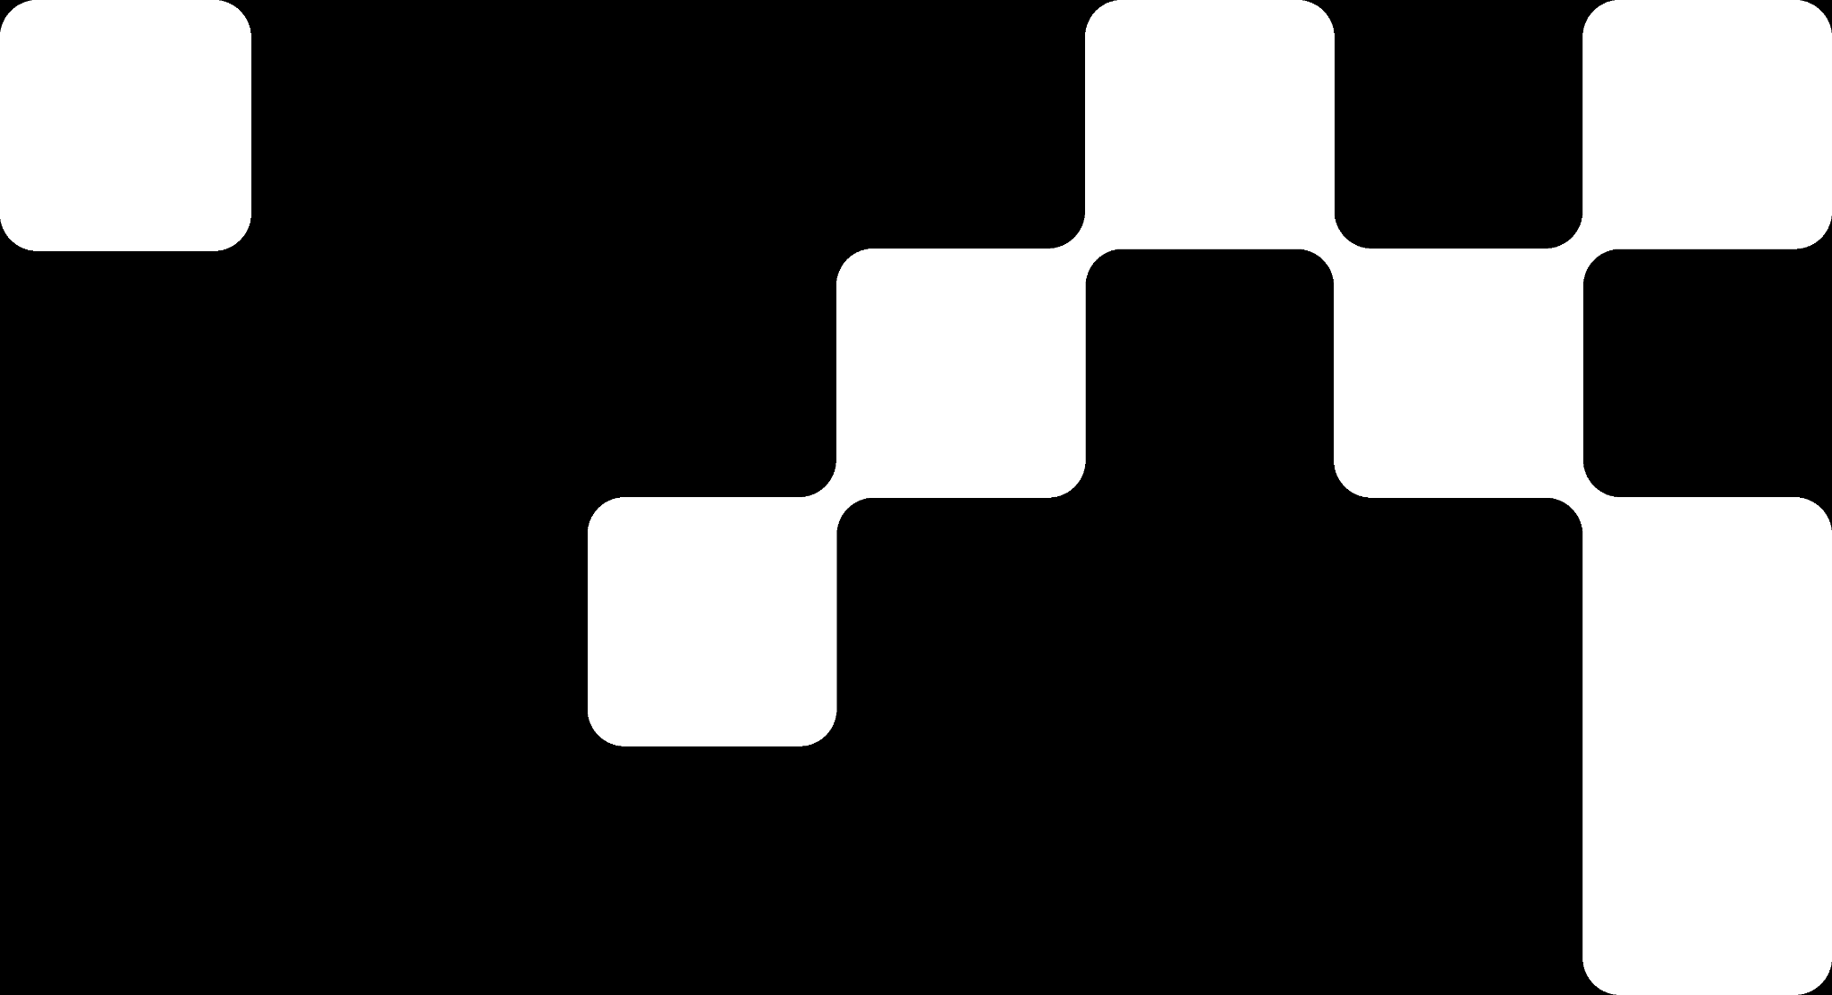

Hands On Exercise
Click Here For The Implementation of VAE for Image Compression https://drive.google.com/file/d/1wox2PYfI3GELWNgK_0FEDESqaTjj1yU9/view?usp=share_link
Anomaly detection with VAE

Slide 21
Books and References
"Neural Networks and Deep Learning" (Michael Nielsen)
Deep Learning for Computer Vision (Rajalingappaa Shanmugamani)
https://www.geeksforgeeks.org/variational-autoencoders/
https://www.ibm.com/think/topics/variational-autoencoder
Goodfellow, I., Bengio, Y., & Courville, A. (2016). Deep Learning. MIT Press.
Chollet, F. (2017). Deep Learning with Python. Manning Publications.
Hochreiter, S., & Schmidhuber, J. (1997). Long Short-Term Memory. Neural Computation.

Slide 22

















الشراكات العالمية

Slide 23
شــــــكــــرًا لكــــــم
THANK YOU

